Slide 1
Project 1
By Jacob Boullion

Slide 2
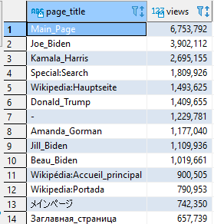

Question 1
Selected the page title and counted
all the views for that title.

Slide 3
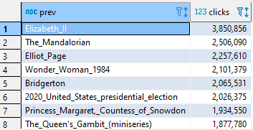
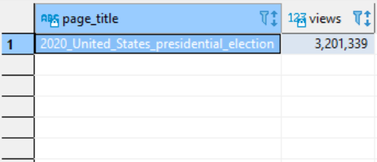
Question 2
I started by finding the pages that
had the most internal clicks to
another page.
Then I chose a page that would give me
logically sound results according to
the day of page view data I collected.
I divided the clicks by the amount
of page views, (2,026,375 / 3,201,339),
which resulted in 63.2% of viewers
clicked an internal link to another page
assuming each click is an individual
person.

Slide 4
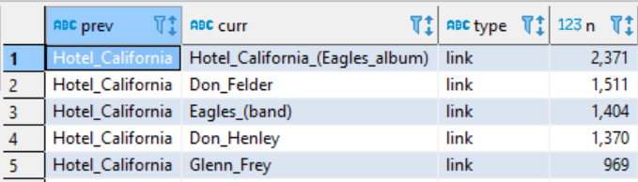
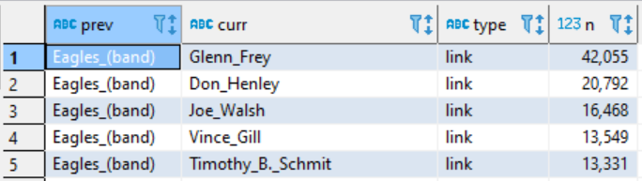
Question 3
n = clicks
Find the top internal link click
starting at Hotel California
The top 4 were used to see which
series had the highest percentage.

Slide 5
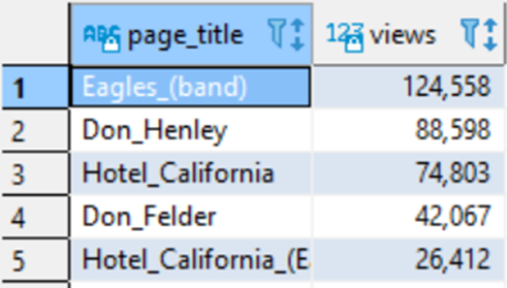
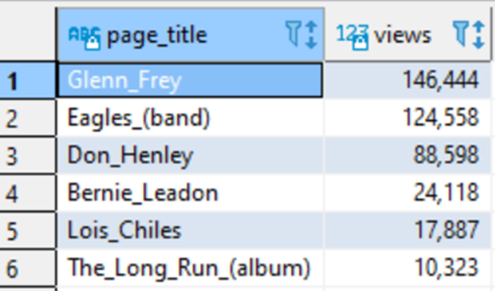
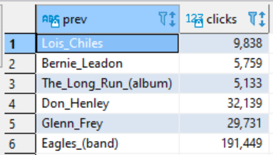
Process for the series:
Hotel California -> Eagles Band -> Don Henley
(1,404 / 74,803) x (20,792 / 124,558) x (32,139 / 88,598)
= (0.0188 x 0.1669 x 0.3628)
= 13.84%
Top 4 series of links percentages:
Hotel_California -> Hotel_California_(Eagles_album) -> The_Long_Run_(album) = 12.5%
Hotel_California -> Don_Felder -> Bernie_Leadon = 1.29%
Hotel_California -> Eagles_(band) -> Don_Henley = 13.84%
Hotel_California -> Don_Henley -> Lois_Chiles = 3.1%

Slide 6
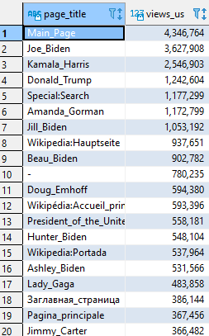
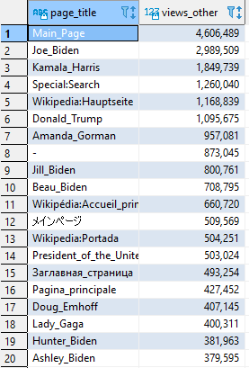
Question 4
Table 1:
Pull page views data from
7am to 9pm CST or
1pm to 2am UTC
for most U.S. view traffic
Table 2:
Pull page views data from
5am to 8pm UTC
(Coordinated Universal Time)
for most view traffic for the
rest of the world

Slide 7
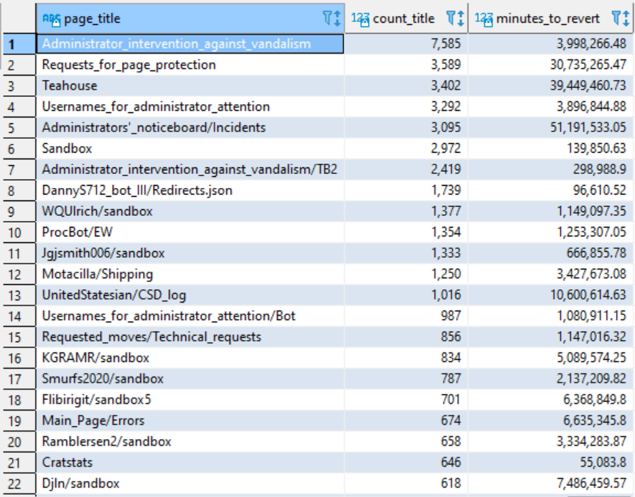
Question 5
If the page was reverted, then that
Page would be counted and the
most counted titles would be
assumed to be the most vandalized.
Some of these pages did not exist in
my page views data set, so I selected
three random pages Teahouse,
Sandbox, and Elliot Page further
down the list.

Slide 8
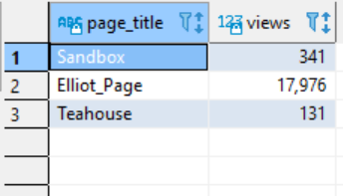
A.
B.
C.
Average time to revert page:
1. Elliot Page took 10.7 hrs before reverted
2. Teahouse took 8.1 days before reverted
3. Sandbox took 47 mins before reverted
Average views per hour for each page:
1. Elliot Page ~= 749
2. Teahouse ~= 5.5
3. Sandbox ~= 14.2
D.
Percentage of viewers who saw
The vandalized page:
Elliot Page: 8,015 / 17,976 ~= 44%
Teahouse: 131 / 131 = 100%
Sandbox: 11 / 341 ~= 3%
How many viewers saw the vandalized page
that day assuming a revert happens once a day:
Elliot Page: 10.7 x 749 ~= 8,015
Teahouse: 131
Sandbox: 47 x 0.236 ~= 11
Average percent of viewers who see frequently
vandalized pages:
49%

Slide 9
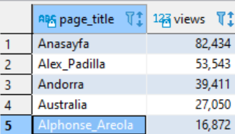
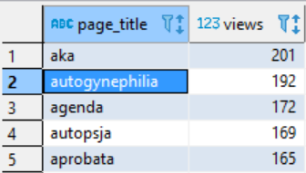
Question 6
Find the most viewed page from a single
Day where the page title starts with ‘a’ and
ends with ‘a’.
Selected page titles that matched that
Description.

Slide 10
GitHub Link
https://github.com/jacobboullion/revature

